Slide 1


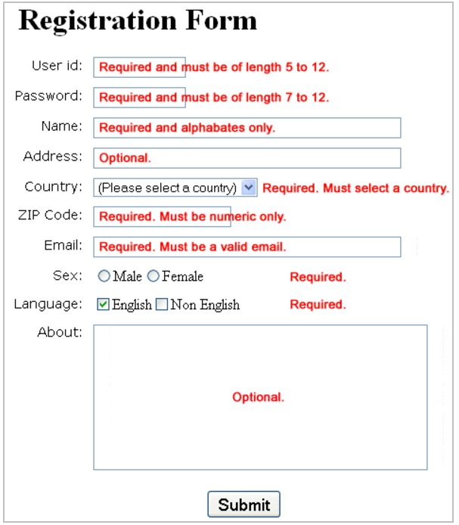
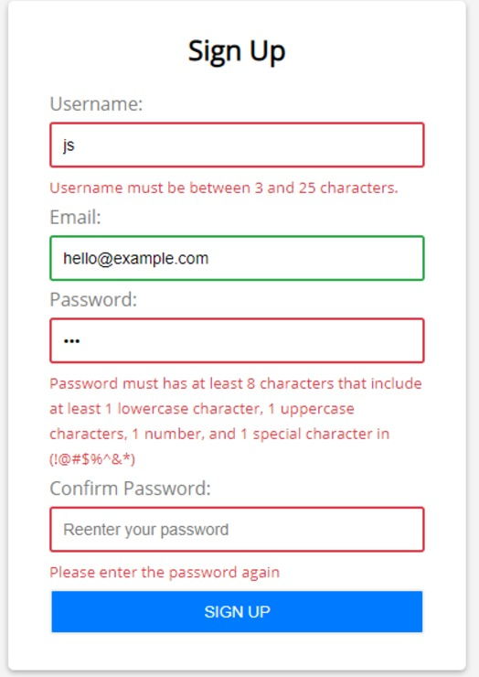
Create Forms by using Html & CSS as shown in the image and Validate by using Java Script
Form Validations

